Slide 1

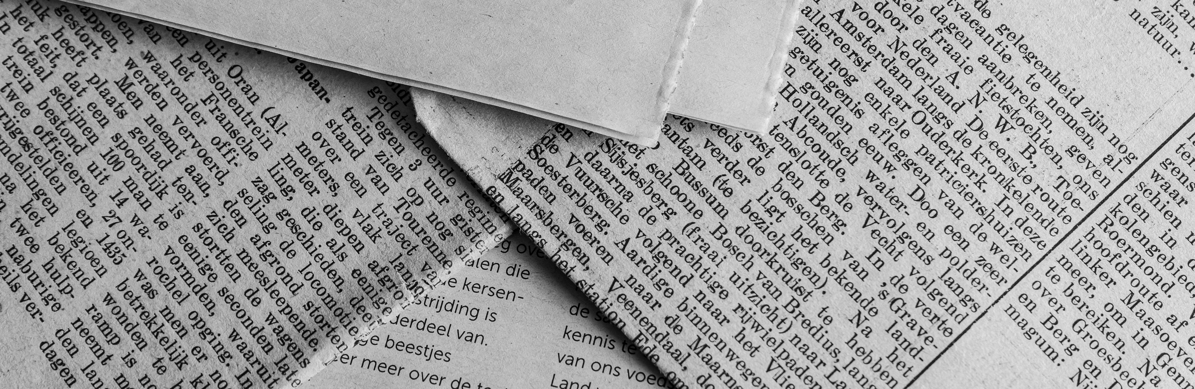
FAKE NEWS DETECTION THROUGH TEXT MINING: IDENTIFYING PATTERNS AND TRENDS USING TF-IDF
DONE BY: ZAINEH MIHYAR

Slide 2

Purpose Statement
The study uses text mining techniques to detect patterns in fake news using TF-IDF (Term Frequency-Inverse Document Frequency) to identify frequently used words in fake news articles. Analyzes trends in misinformation during major global events.

Slide 3
Research Objectives
Identify the words and phrases that are frequently used in fake news.
Analyze the types of news that tend to have more fake news (e.g. politics, economics, etc..).
Study how fake news trends evolve in response to global events.
Use TF-IDF to analyze word importance and trends across fake and real news.

Slide 4

Source of Data
Primary Data
Secondary Data
Surveys on fake news perception and detection strategies.
Participant demographics and behaviors related to news consumption.
Kaggle dataset with labeled fake and real news articles.
Includes thousands of articles from various news sources.
Data Collection
Data Collection
Surveys conducted online to gather news consumption habits and fake news awareness. Through google forms
Data Analysis using Text-mining analysis (TF-IDF)

Slide 5



DATA ANALYSIS TOOLS
Python
Text Mining
Visualization Tools
TF-IDF to analyze word frequency
Word clouds to highlight key fake news terms

Slide 6

Main Findings and Results
International Affairs and Entertainment are the most targeted topics
Fake news spikes during major events (e.g., 2016 U.S. elections).
Younger individuals rely on social media, while older demographics prefer traditional news sources.
Fake news uses sensationalist language, while real news uses more institutional terms.

Slide 7
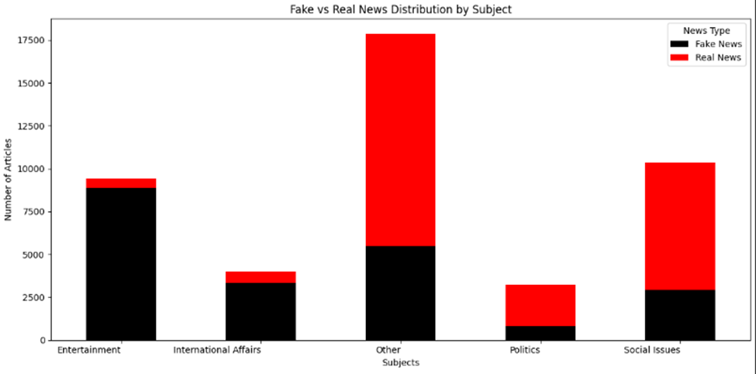

Slide 8
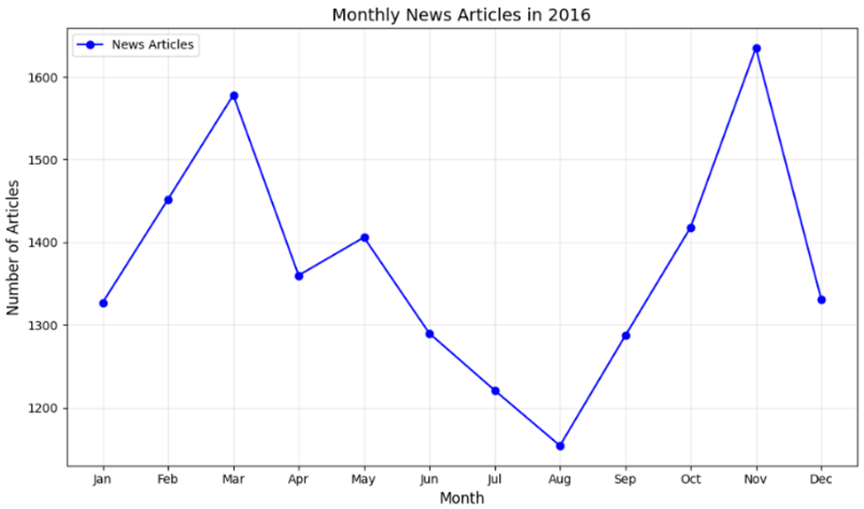
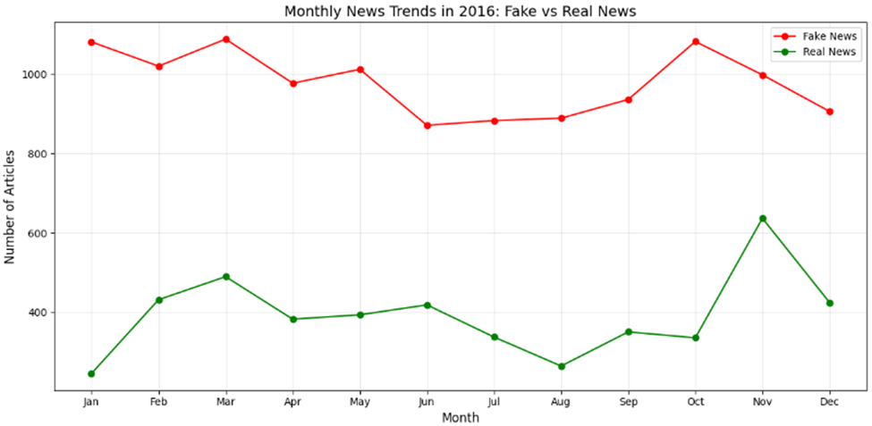

Slide 9
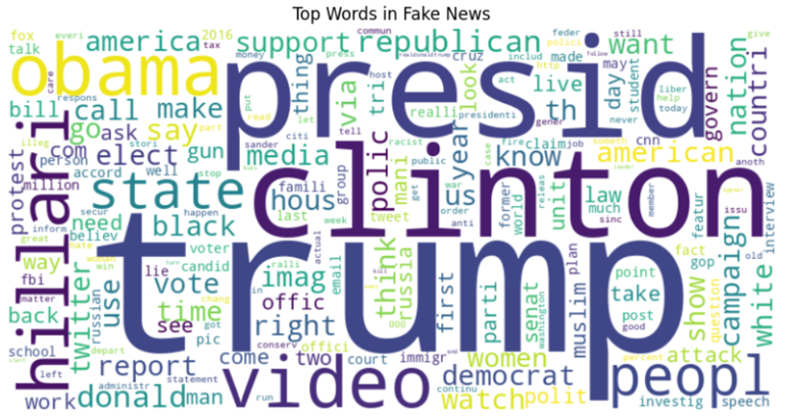

Slide 10
Recommendations and Action plan for improvement
Develop AI-based fake news detection models using advanced NLP (BERT, deep learning).
Expand datasets to include non-English and multimedia misinformation (images, videos)..
Enhance public awareness to check the reliability of news.
Social media partnerships to reduce algorithmic spread of misinformation.
Develop real-time monitoring systems for detecting fake news.

Slide 11
THANK YOU FOR LISTENING!

